Slide 1
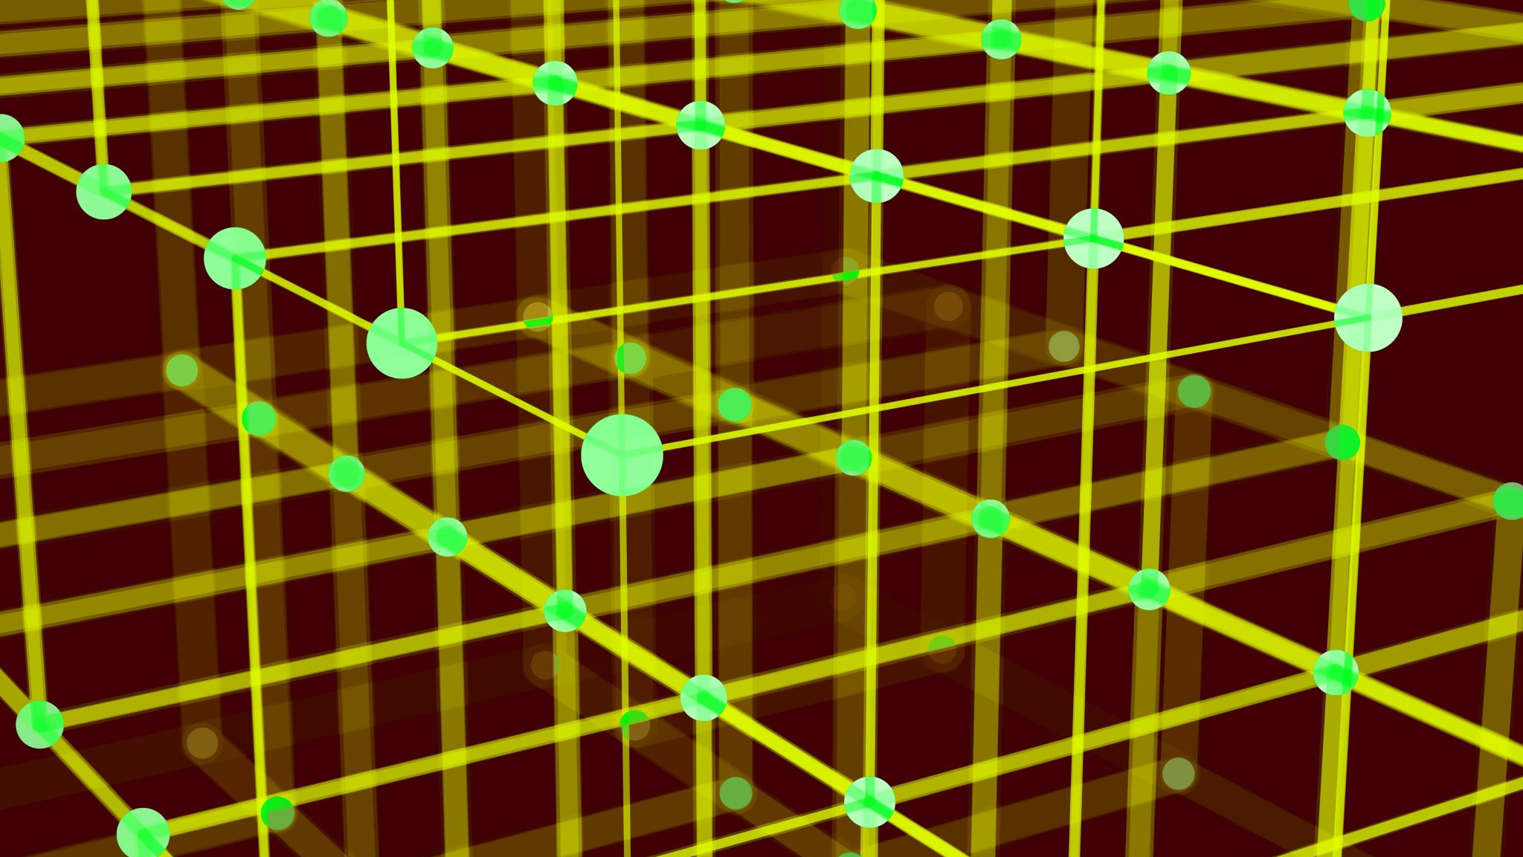
Quantum Computing
Group B

Slide 2
Quantum Logic Basics
Just like the bit is the basic unit of information of a classical computer, a qubit is the basic unit of information of a quantum computer.
A qubit a superposition of binary states 0 and 1, that is, it uses the quantum mechanical phenomena of superposition to achieve a linear combination of two states.
With the use of quantum gates, which are essentially unitary operators (described by unitary matrices), we can build quantum circuits, just like the classical gates are the building blocks of classical circuits.

Slide 3
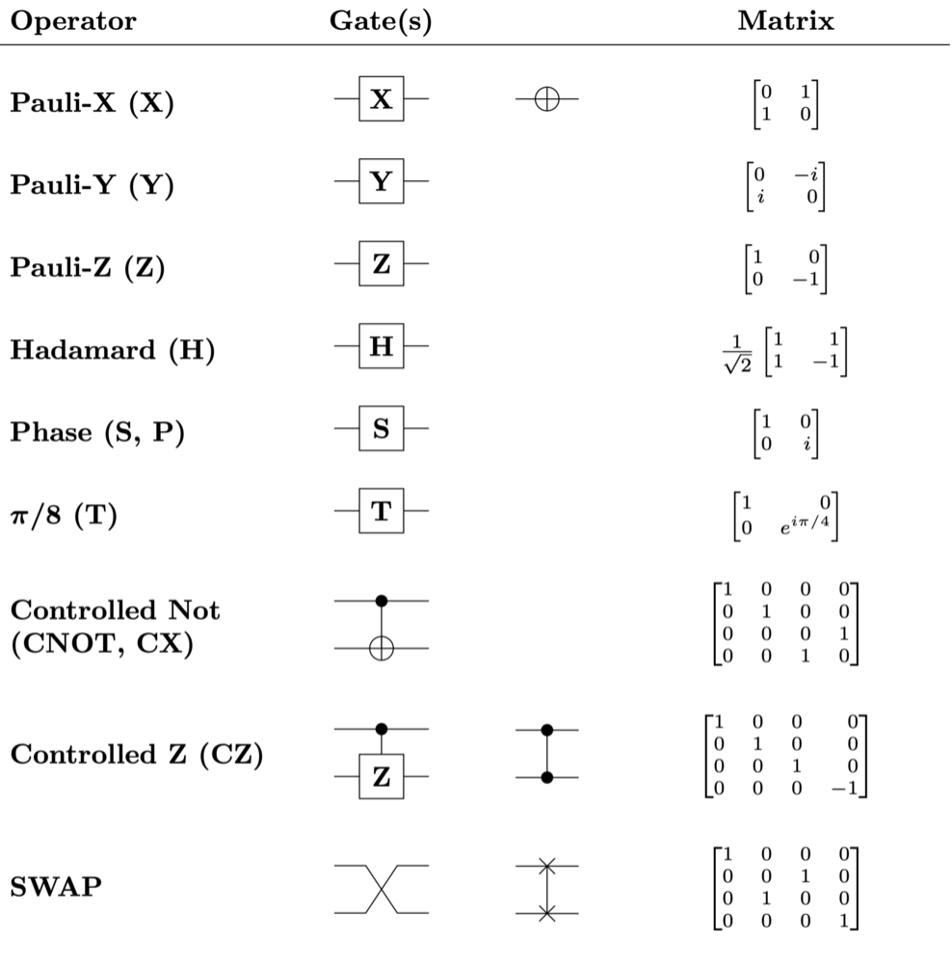
Quantum Logic Basics
There are different types of quantum
gates, the basic ones are:

Slide 4
Projects
We are working on two different quantum computing projects
Project 1: Grover’s search algorithm
Project 2: Breaking RSA encryption using Shor’s algorithm

Slide 5
Project 1: Grover’s search algorithm
Grover’s algorithm is a quantum search algorithm that can search for a value or element in an unsorted set in time O(√N) as opposed to classical search algorithms that will find an element in O(N) time.

Slide 6
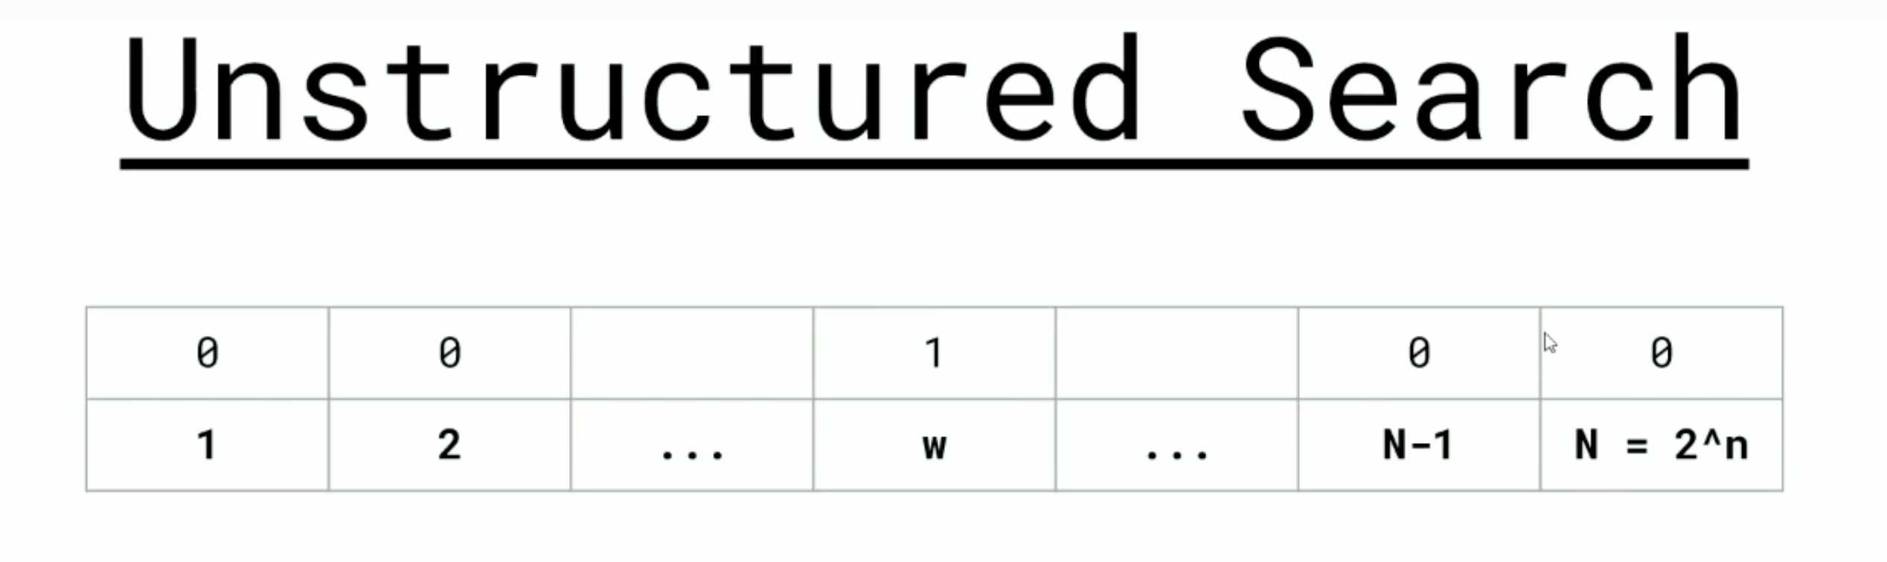
Project 1: Grover’s search algorithm
Suppose we wanted to search for a specific element w in a list of N elements.
A classical computer has on average a computation time of O(N/2) to find element w.

Slide 7
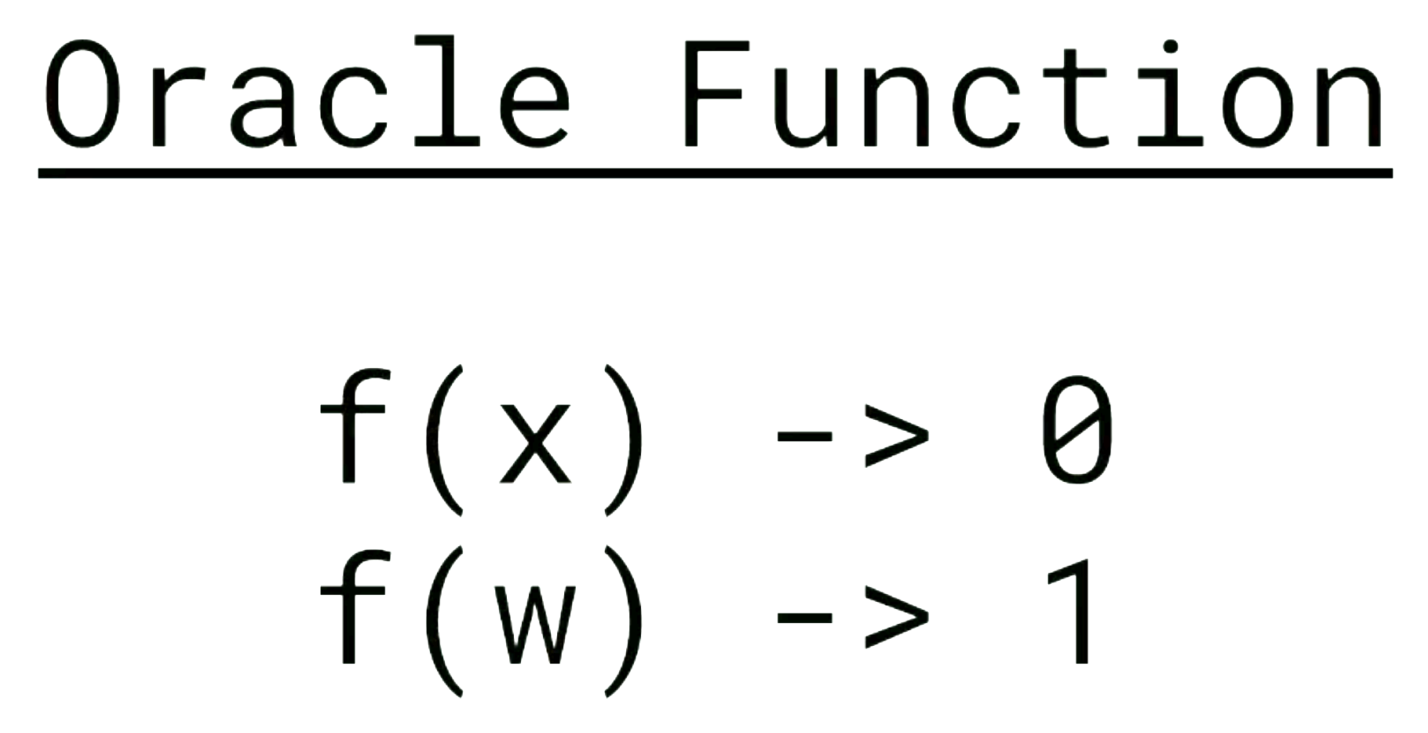
Project 1: Grover’s search algorithm
Grover’s algorithm solves the unstructured search question in O(√N) time.

Slide 8
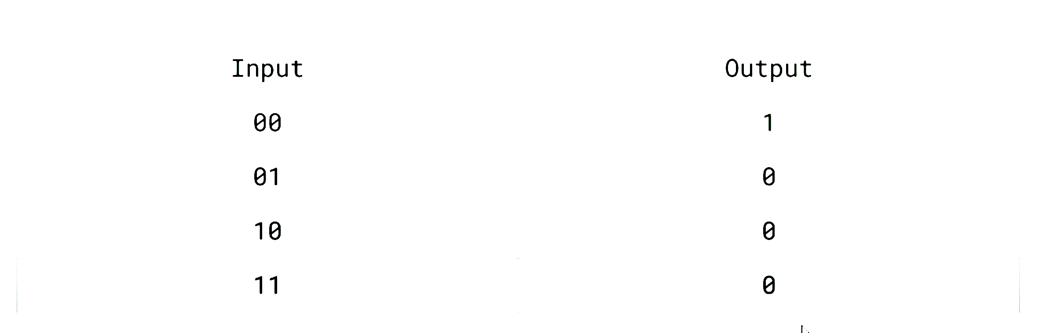


W = 00

Slide 9
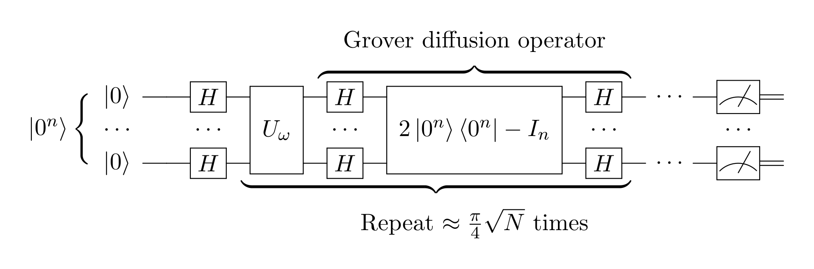

Slide 10
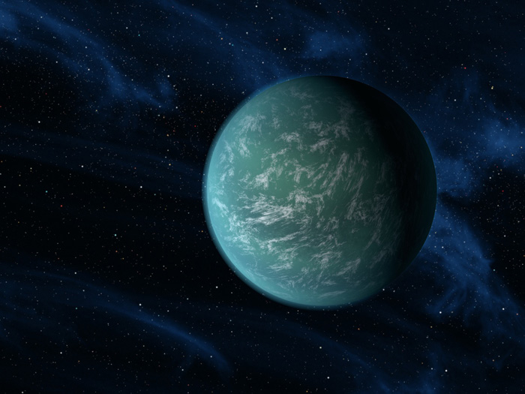
Scanning for habitable planets
We will be using Grover’s Adaptive Search to search through a database for the "most habitable" planet
Grover’s Adaptive Search uses successive applications of Grover's Algorithm to optimise a particular function

Slide 11
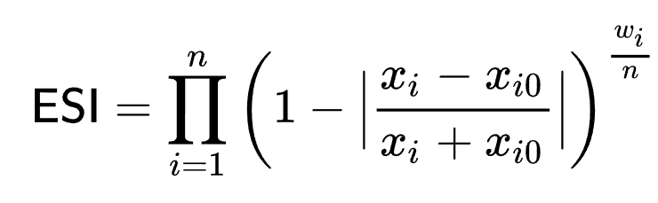
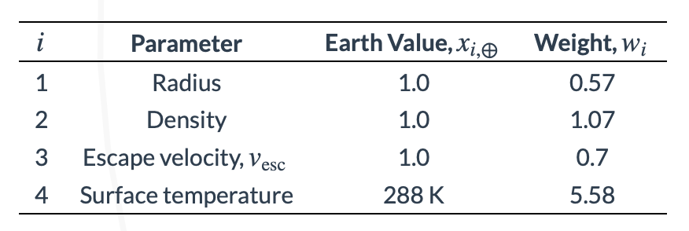
Defining Habitability
We will use the Earth Similarity Index (ESI)
Score between 0 and 1, with 1 being identical to Earth
Different properties are weighted by different amounts
Data will come from The Extrasolar Planets Encyclopedia

Slide 12
Grover Adaptive Search
Optimises a function by taking a guided random walk through the input space
Start from an initial random choice of planet and then use Grover's algorithm to find better and better planets

Slide 13
What then?
How fast is it for different sample sizes?
How accurate is it? How does iteration count affect this?
How does it compare to a classical search? (we expect this simulation to be quite slow)
Can we optimise the simulation?
Can we run our code on an actual quantum computer?

Slide 14
Project 2: Shor's Algorithm and RSA encryption
RSA is a widely used encryption algorithm for data transmission. The algorithm encodes some given message using the product of two large prime numbers and sends this value across a network. The security of this algorithm hinges on the fact that is extremely difficult to find prime factors of a number that large. Shor's algorithm can bypass this limitation by finding prime factors of extremely large numbers in polynomial time.

Slide 15
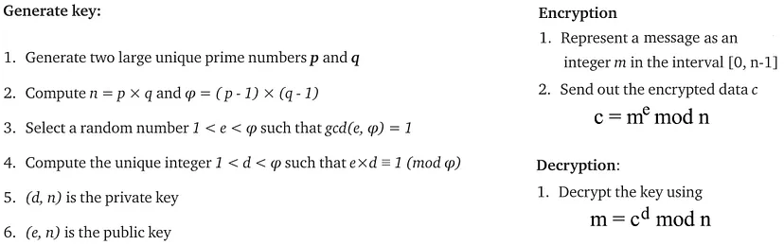
RSA Algorithm
The algorithm works by encrypting Alice's message with the public key, which can be known by everyone. The encrypted message is then sent across a network to Bob, who then decrypts the message with the private key, which only he has access to. Shor's algorithm is so powerful here because it bypasses the need for the private key and can decrypt the message with only the public key.

Slide 16
Shor's Algorithm Classical Part
The algorithm is used to find a non-trivial square root b of 1 modulo N that is not equal to ±1. Therefore, two non-trivial divisors gcd(N, b±1) of N are produced. The algorithm consists of a classical part and a quantum part.
The classical part selects a random number 1 < a < N and calculates the greatest common divisor of a and N. If this is non-one, we are done. If the greatest common divisor is trivial, then a quantum period-finding subroutine is required to find the period r of the function:
f(x) = a^{x} mod(N).
If this period is odd, or if a^{r/2} = -1mod(N), then another a is chosen at random, and the algorithm is restarted.
Otherwise, the two non-trivial divisors are:
gcd(a^{r/2}±1, N).

Slide 17
Shor's algorithm Quantum part (period-finding subroutine)
An integer Q = 2^{q} is chosen such that N² ≤ Q < 2N², where q is the number of qubits. The initial state is set to be an equal superposition of all Q states. n more qubits are needed to become entangled with the original qubits. The inverse quantum Fourier transform is applied to the input register using the Qth root of unity. This final state is a superposition of more than Q states and is then reordered.

Slide 18
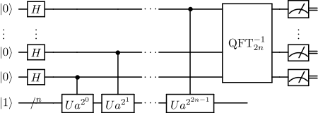
Shor's algorithm Quantum part (period-finding subroutine)
A measurement is performed, obtaining outcomes in the input and output registers with a certain probability. This can then be used to calculate the period r. Classically; this is checked to hold. If the period does not correspond classically to f, then the subroutine is restarted.

Slide 19
Quantum-broken cryptosystems
RSA, ECC, DSA, ECDSA, EdDSA are popular public-key cryptosystems, and are all quantum-broken!
We will be using Shor's algorithm to try and break RSA (and maybe DSA).
Naturally to break industrial level RSA encryption we would need an unrealistically large number of qubits, but it is possible to break lower bit RSA with just 10 qubits.
This is important for the future of security for classical computers, as anyone with a quantum computer can break the above algorithms.

